Slide 1





EpiGNN: Exploring Spatial Transmission with Graph Neural Network for Regional Epidemic Forecasting.
The European Conference on Machine Learning and Principles and Practice of Knowledge Discovery in Databases
Feng Xie, Zhong Zhang, Liang Li, Bin Zhou*, Yusong Tan
National University of Defense Technology, Hunan, China
Department of Computer Science and Technology
xiefeng@nudt.edu.cn

Slide 2
Outline
Background & Motivations
Problem Formulation
Methodology
Experiements
Future Work and Conclusions

Slide 3








Background & Motivations
administrative decision-making
statistic
government
...
epidemic statistic
(e.g., comfirmed case)
allocating health-care resources
virus
human-to-human interaction
hospital
Epidemics spread through human-to-human interaction and circulate worldwide, seriously endangering public health.
Seasonal influenza: The World Health Organization (WHO) estimates that seasonal influenza annually causes approximately 3-5 million severe cases and 290,000-650,000 deaths [1].
Other epidemics: In recent years, the COVID-19 has spread to more than 200 countries and territories around the world [2].
Accurate Epidemiological Forecasting:
provides opportunities for driving administrative decision-making and，
timely allocating healthcare resources.
helps with drug research (i.e., vaccines) which leads to reduce financial burdens and deaths.

Slide 4
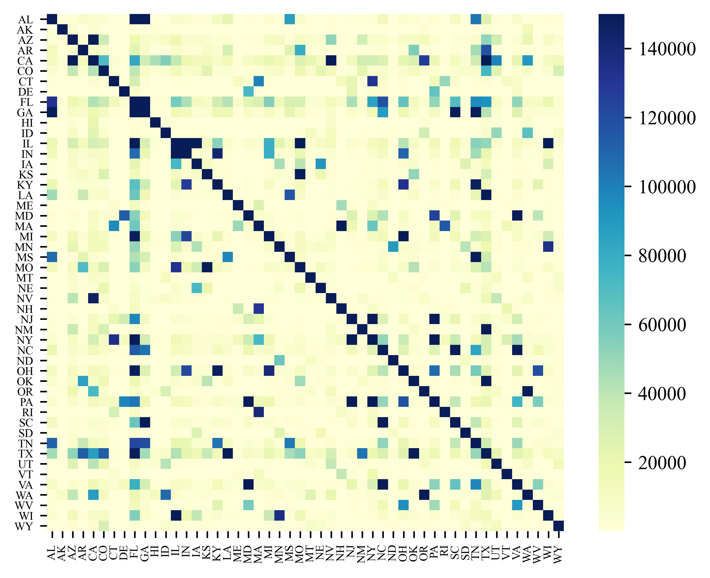
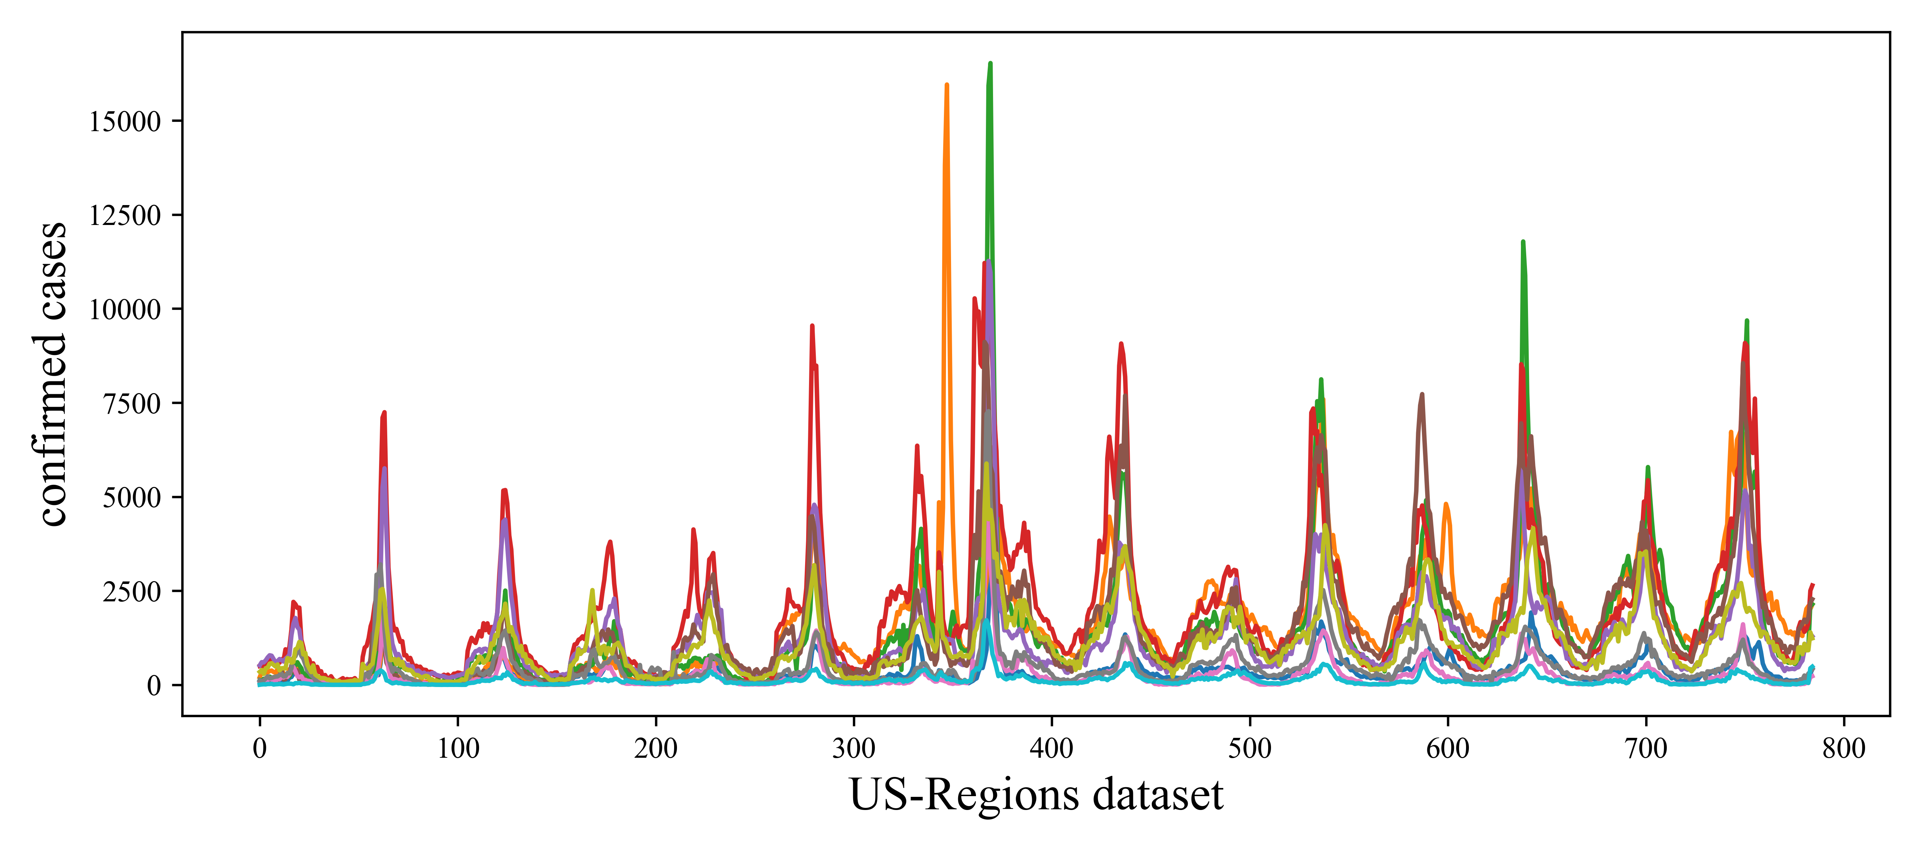
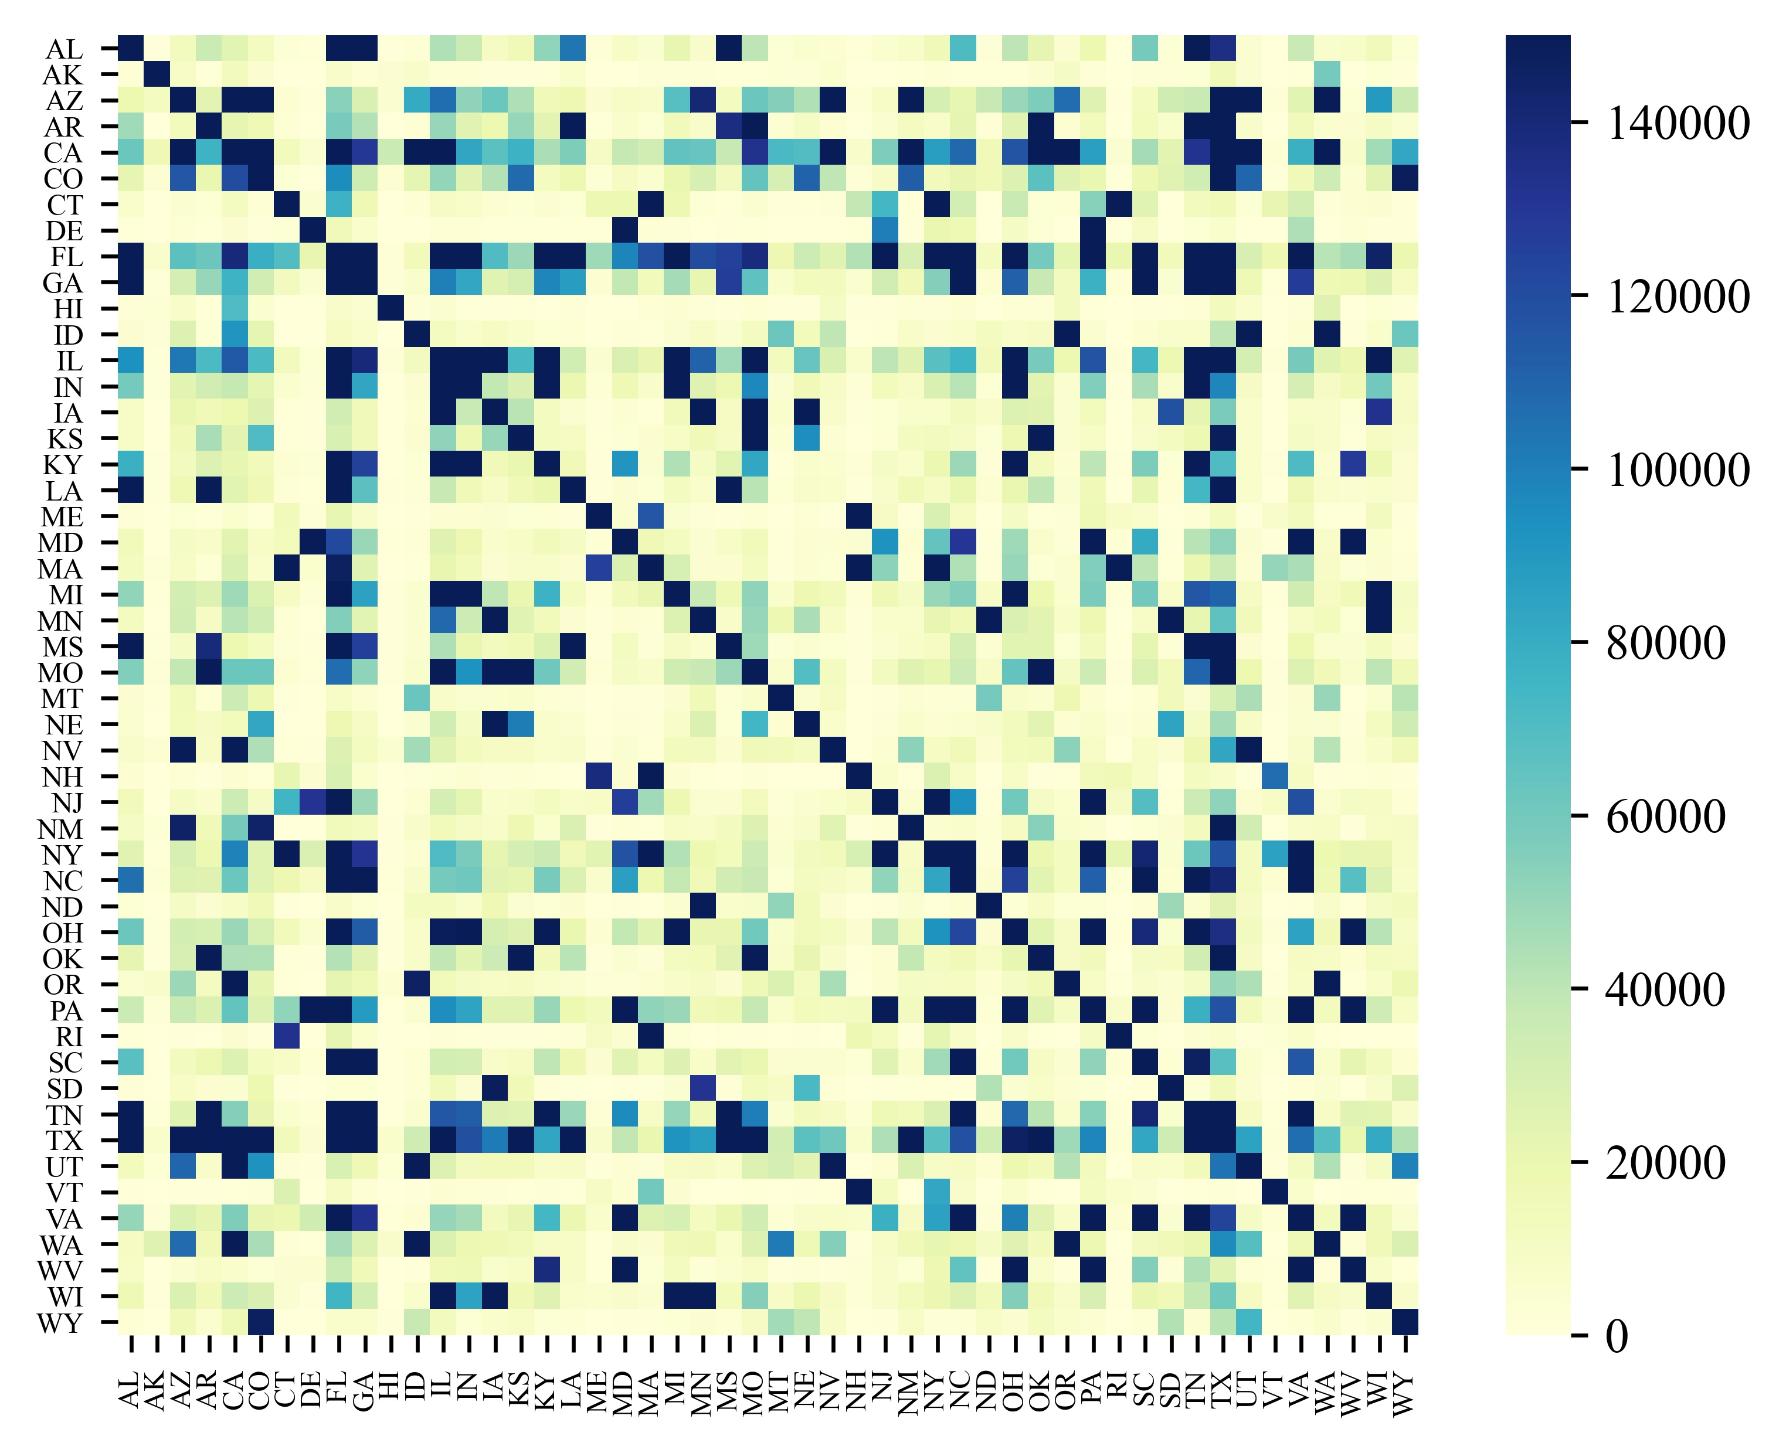
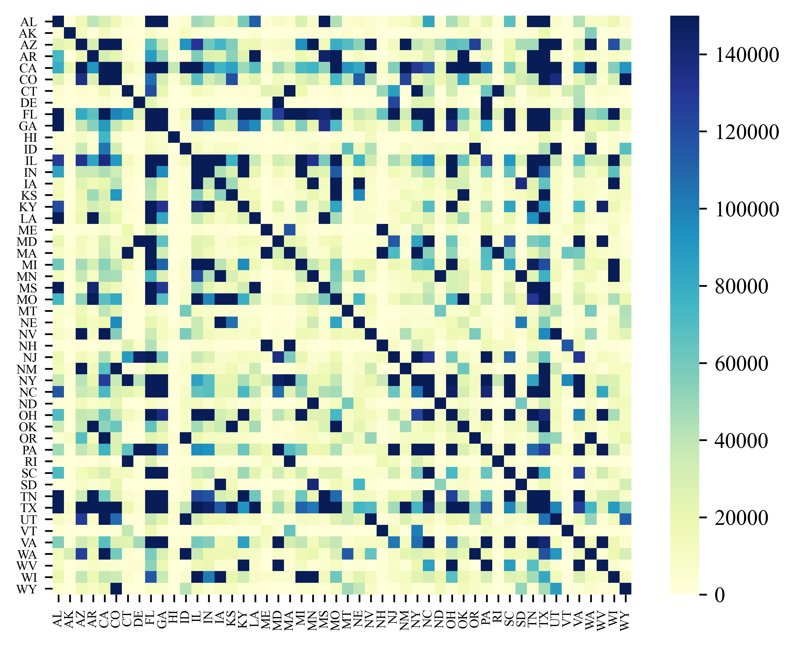
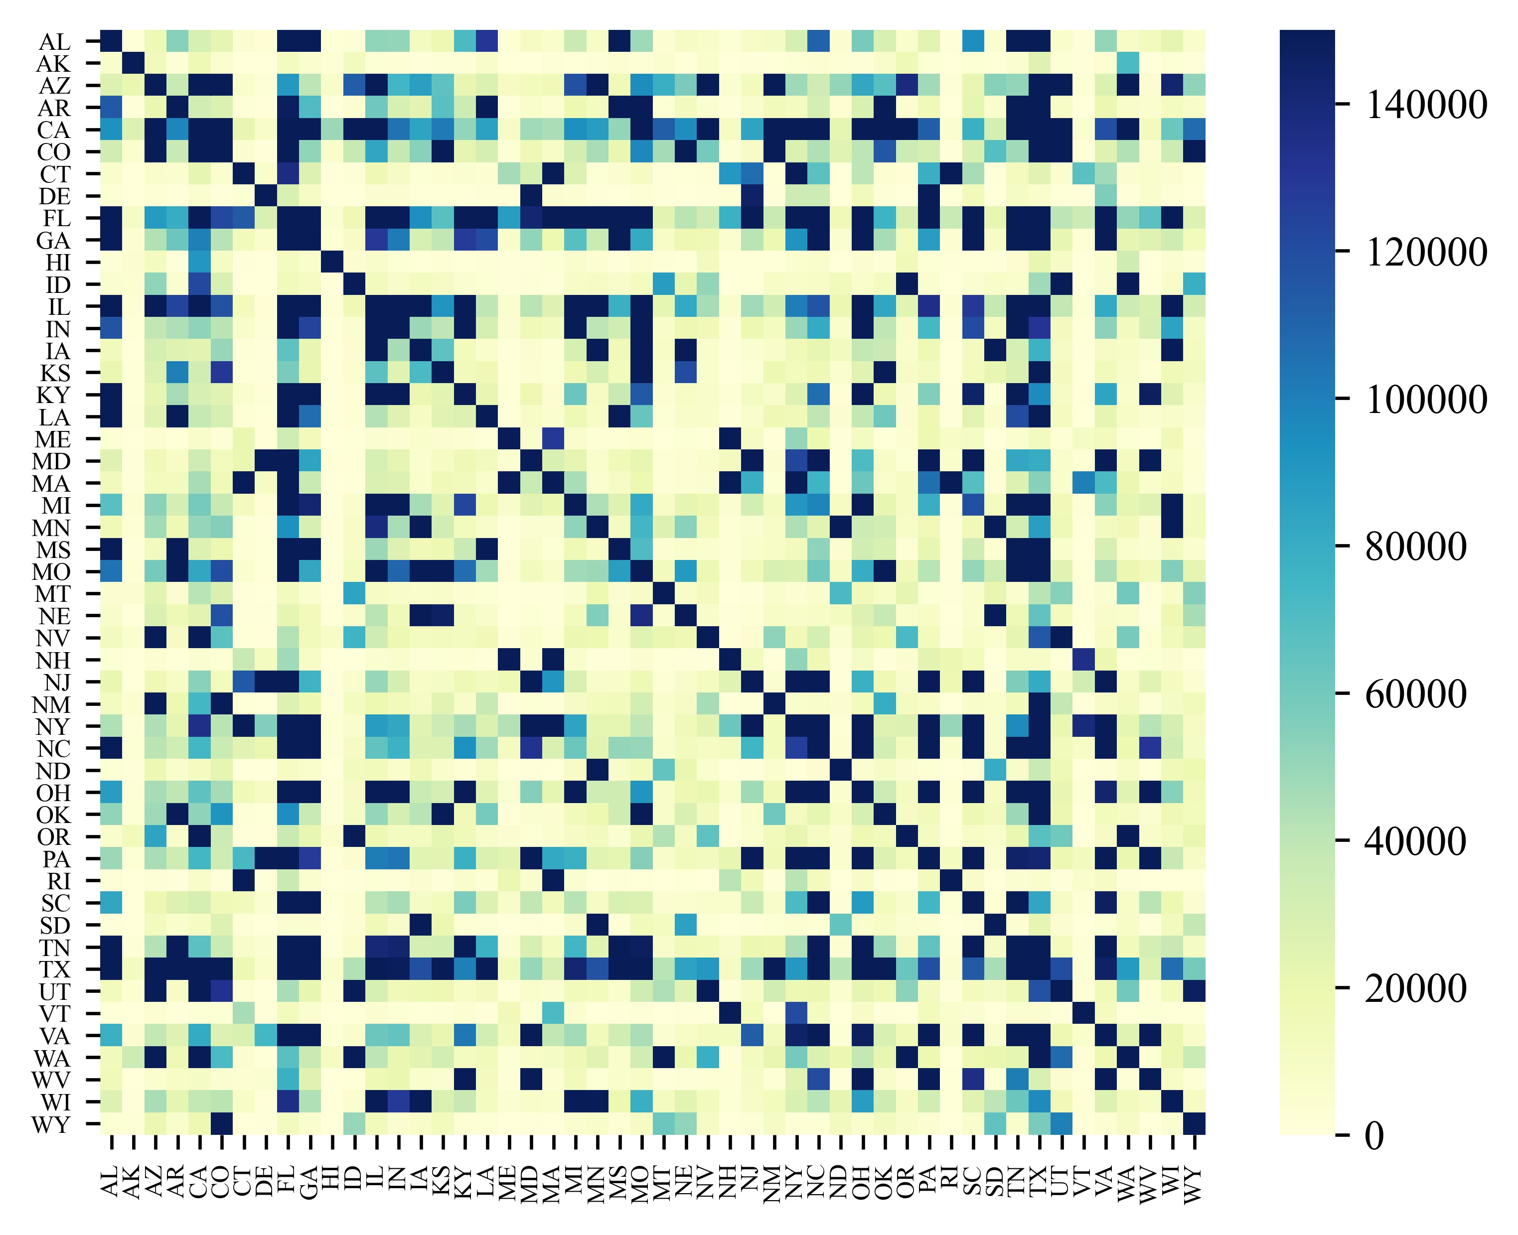
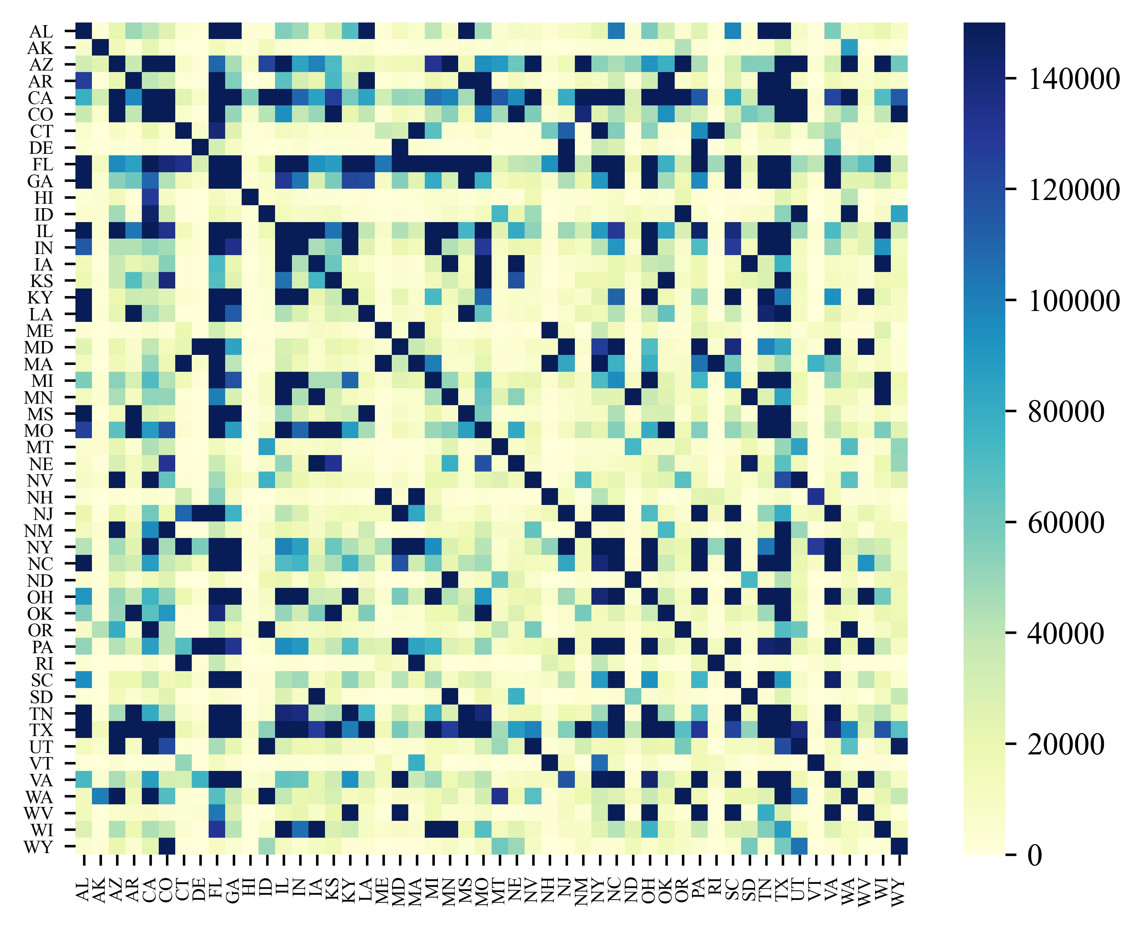
Background & Motivations
Main characteristics of this task
The inherent difficulty of long-term forecasting
Nonlinear temporal dependencies (e.g., seasonal influenza in Fig.1)
dynamic inter-dependencies between regions (e.g., human mobility in Fig.2)
2020/5/05 - 2020/6/01
5/05-5/11
5/12-5/18
5/19-5/25
5/26-6/01
Figure 2. The overall of human mobility flow between different states within Covid-19 period in US (2020).
Figure 1. The overall of the flu statistic of US HHS regions.

Slide 5


Background & Motivations
Exsiting Methods
Statistic Methods: AR, ARIMA, SARIMA.
Compartment Methods: SIR, SEIR, SEUIR.
Deep Learning-based Methods: CNNRNN-Res, Cola-GNN, MPNN, SMART, etc.
Traditional methods
GNN-based methods
geographic
topology
region 1
...
region 2
...
model as a graph
a model
(e.g. SARIMA)
edge-level
region N
node-level
time series matrix
future time point
t + h

Slide 6
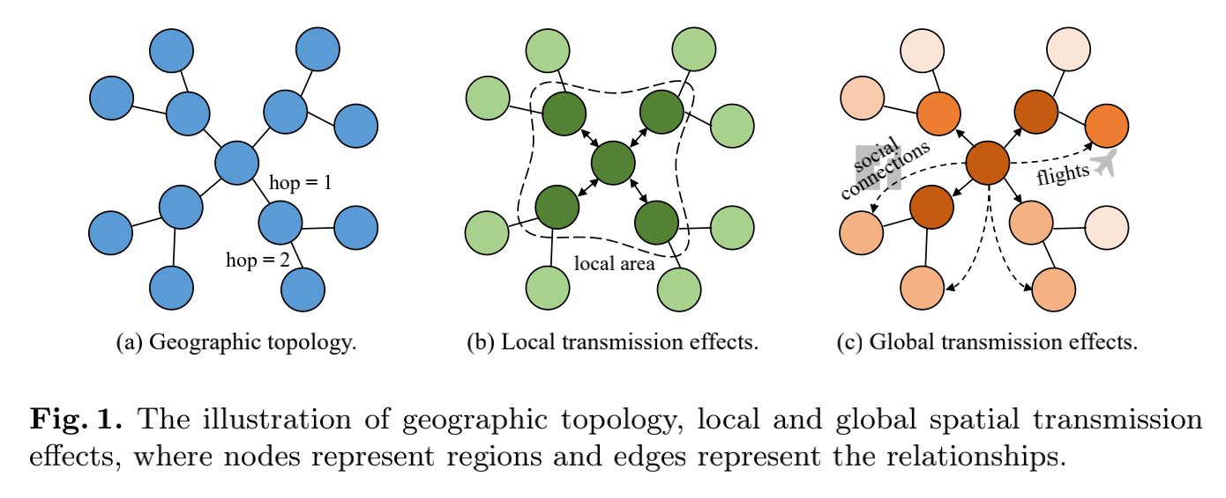
Background & Motivations
1. Spatio-Temporal Graph Construction
Explicit graph structures (e.g., geographic topology):
does not necessarily reflect the true dependencies.
hard to capture hidden correlations.
Using external data (e.g., human mobility):
data availability, data accuracy, and data privacy
Graph learning methods (e.g., self-attention):
oversmoothing
noise propagation
Capturing underlying transmission dependencies between regions reasonably and accurately.
the method should flexibly support both scenarios when rich external information can be collected or not.
2. Spatial Transmission Risk: implies a potential ability that the epidemic in one region impacts other regions from a spatial perspective.
the epidemic in one region has not only local effects but also spillover effects across regions through complicated social connections [3]
Local Transmission Risk: geographically adjacent
Global Tansmission Risk: complex social connections

Slide 7
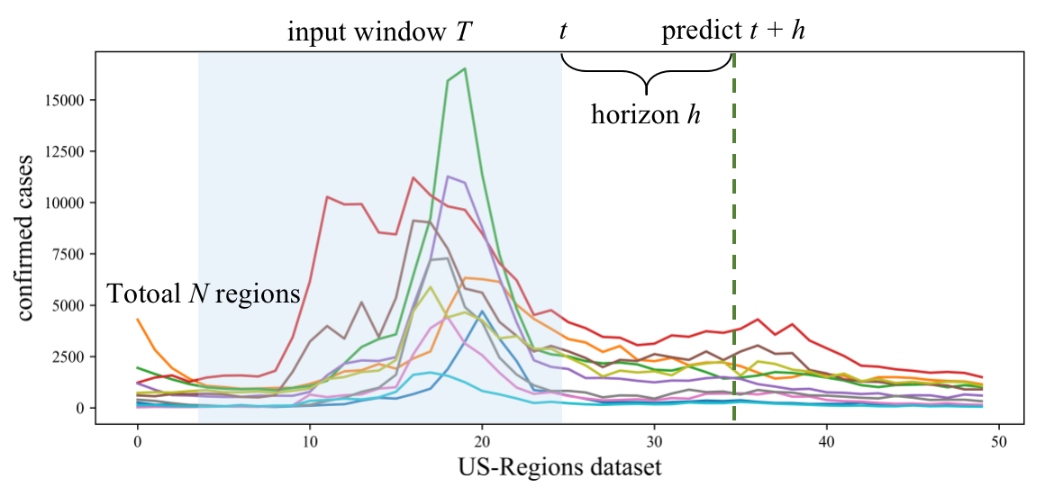
Problem Formulation (Fig.1)
N regions. We have a total of N regions (i.e., states or cities). Each region is associated with a time series for a window T.
Input. Epidemic statistic with a look-back window T at time point t.
Goal. The goal of this task is to predict the epidemic statistic of the future time point t + h.
Figure 1. The illustration of problem formulation.

Slide 8
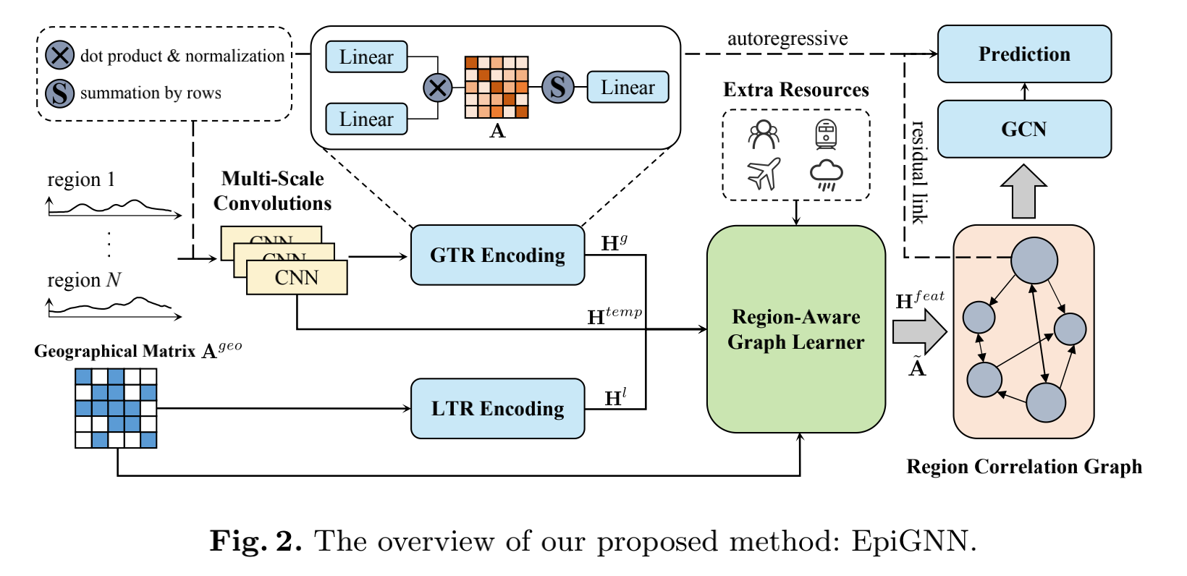
Methodology
Overall
We design a novel graph neural network-based model for epidemic prediction in which a transmission risk encoding module is proposed that shows how we incorporate local and global spatial effects of regions into the model.
We introduce a Region-Aware Graph Learner which takes transmission risk, geographical information, and temporal dependencies into account to better explore underlying spatio-temporal correlations between regions.

Slide 9
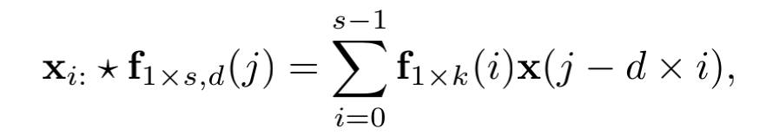
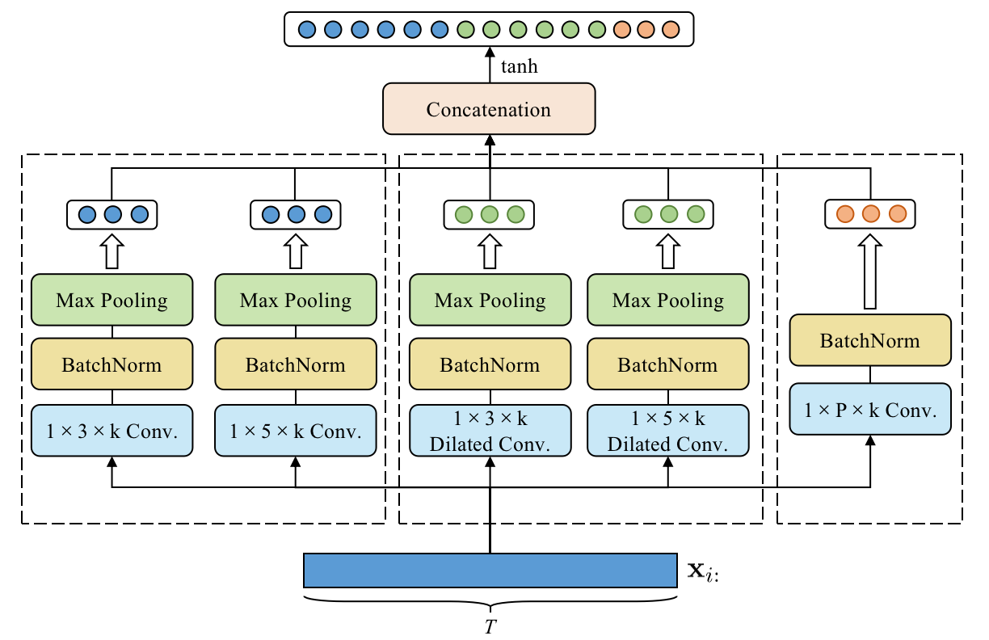
Methodology
Encoder: Multi-Scale Convolutions
Previous works [4,5] suggest that using a set of multi-scale convolutions can capture complex temporal patterns simultaneously. Therefore, in this work, we also adopt multi-scale convolutions with different filter sizes and dilated factors as a feature extractor.

Slide 10
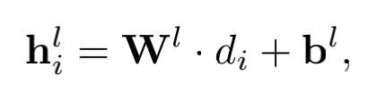
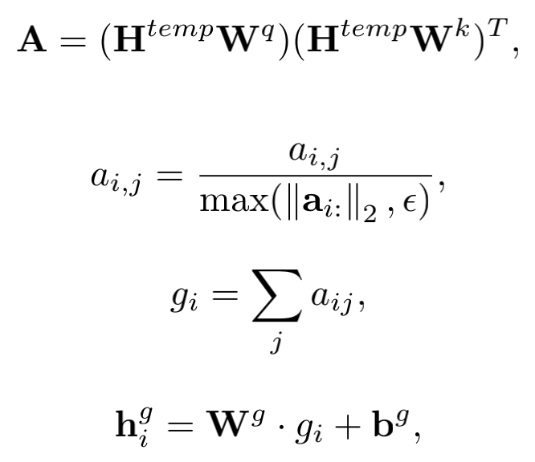
Methodology
Transmission Risk Encoding Module
Local Transmission Risk (LTR) Encoding
The proximity between regions will lead to a rapid increase in the mobility of internal elements between regions (e.g., human mobility), which will exacerbate local transmission risk.
the degree of region i
Global Transmission Risk (GTR) Encoding
Due to the complicated social connections, there are also potential correlations between disjoint regions.
attention

Slide 11
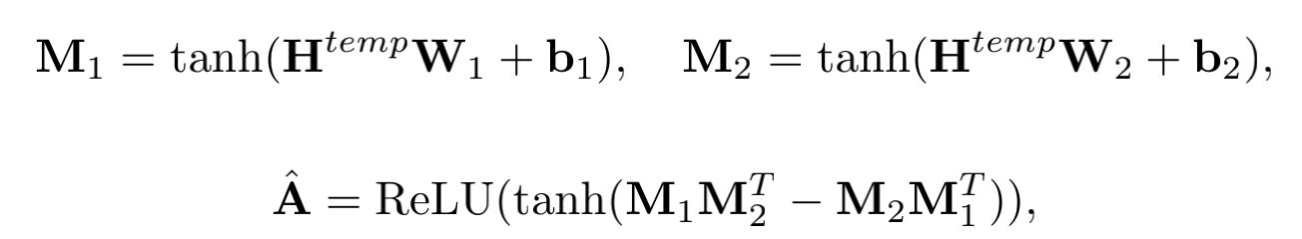
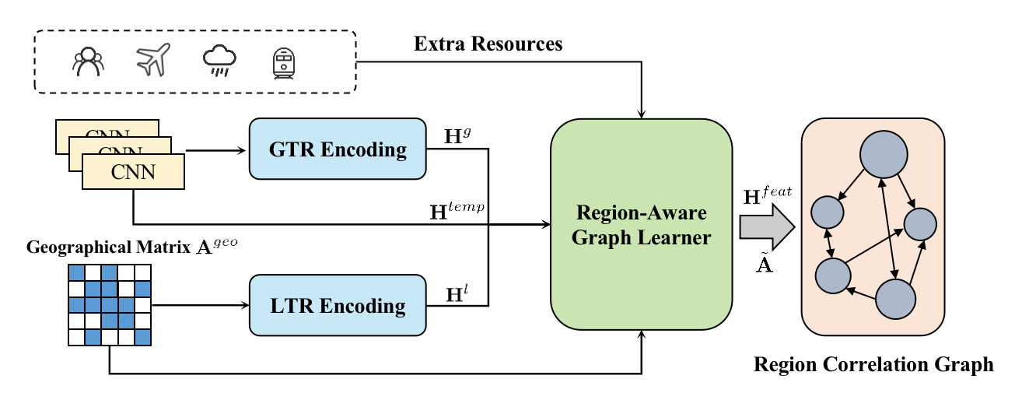
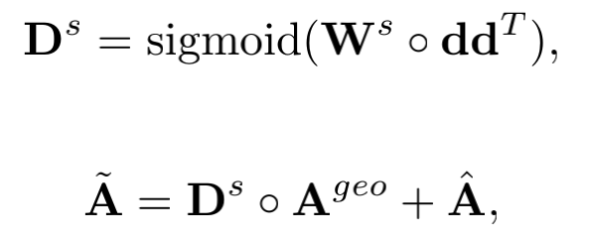
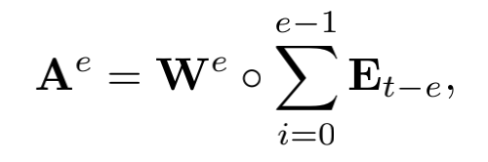
Methodology
Region-Aware Graph Learner
Temporal Correlation
We design a Region-Aware Graph Learner (RAGL), which considers both temporal and spatial information to generate a region correlation graph, where nodes correspond to regions, and edge weights correspond to the correlations between regions.
Spatial Correlation
As a gate
External resources
Fig. The input and output of RAGL

Slide 12
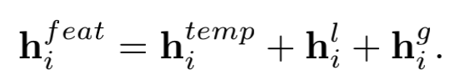
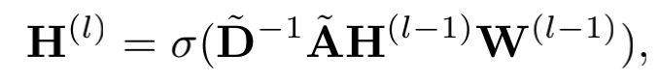

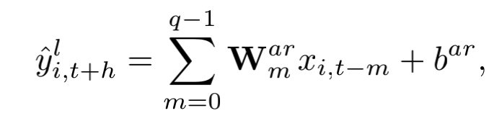
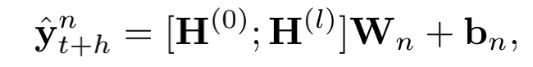
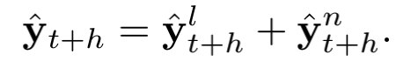
Methodology
Graph Convolution Network and Final Prediction
In this work, we apply GCN [6] to investigate the epidemic propagation among different regions. We apply the following yellow box to update node representations.
Linear Part. Some works have incorporated a linear part to deal with the sensitivity to input and purely nonlinear modeling [7,8].
Nonlinear Part. Neural networks are dedicated to handling the nonlinear characteristics of raw time series.
The final prediction of EpiGNN is obtained by summing the nonlinear part and the linear part got by an AutoRegressive component.
GCN
Final prediction

Slide 13
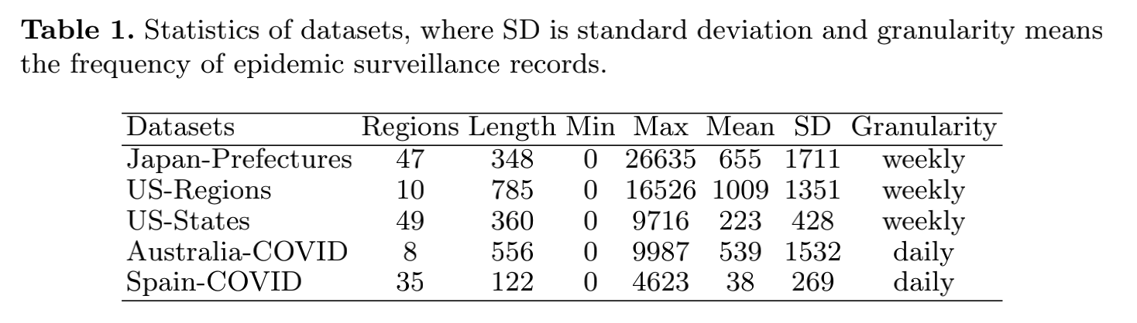
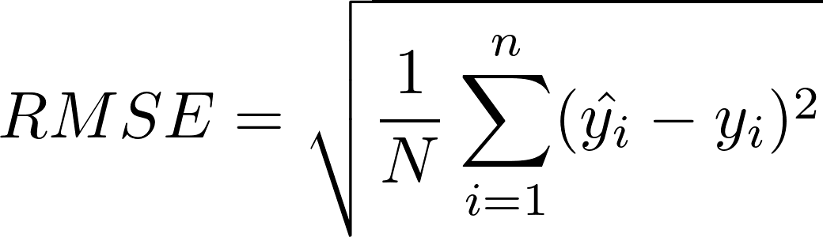
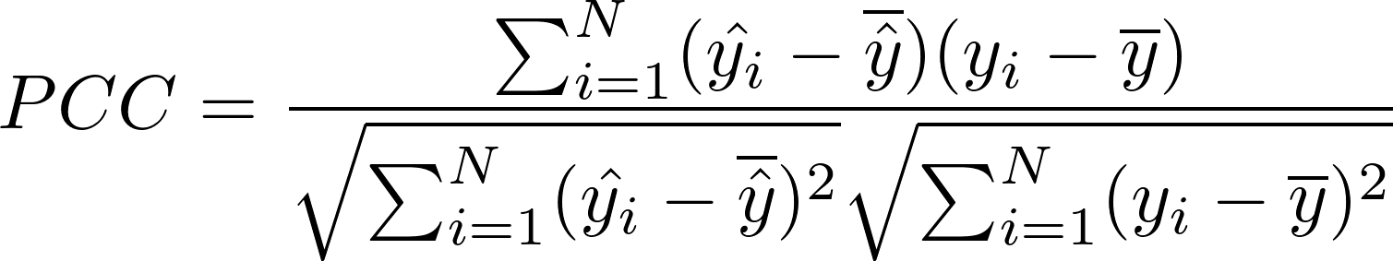
Experimental Settings
Baselines
Datasets
We compared the proposed model with the following methods.
Statistic models: HA, AR.
Deep Learning-based models:
LSTM [9]
TPA-LSTM [ECMLPKDD2019] [8]
ST-GCN [IJCAI18] [10]
CNNRNN-Res [SIGIR2018] [11]
SAIFlu-Net [JBHI2021] [12]
Cola-GNN [CIKM2020] [4]
We prepare five real-world epidemic-related datasets as follows, and their data statistics are shown in Table 1.
Influenza statistics datasets:
Japan-Prefectures
US-Regions
US-States
COVID-19 statistics datasets:
Australia-COVID
Spain-COVID
from Cola-GNN
from JHU-CSSE
Metrics
RMSE
PCC
For RMSE lower value is better, while for PCC higher value is better

Slide 14
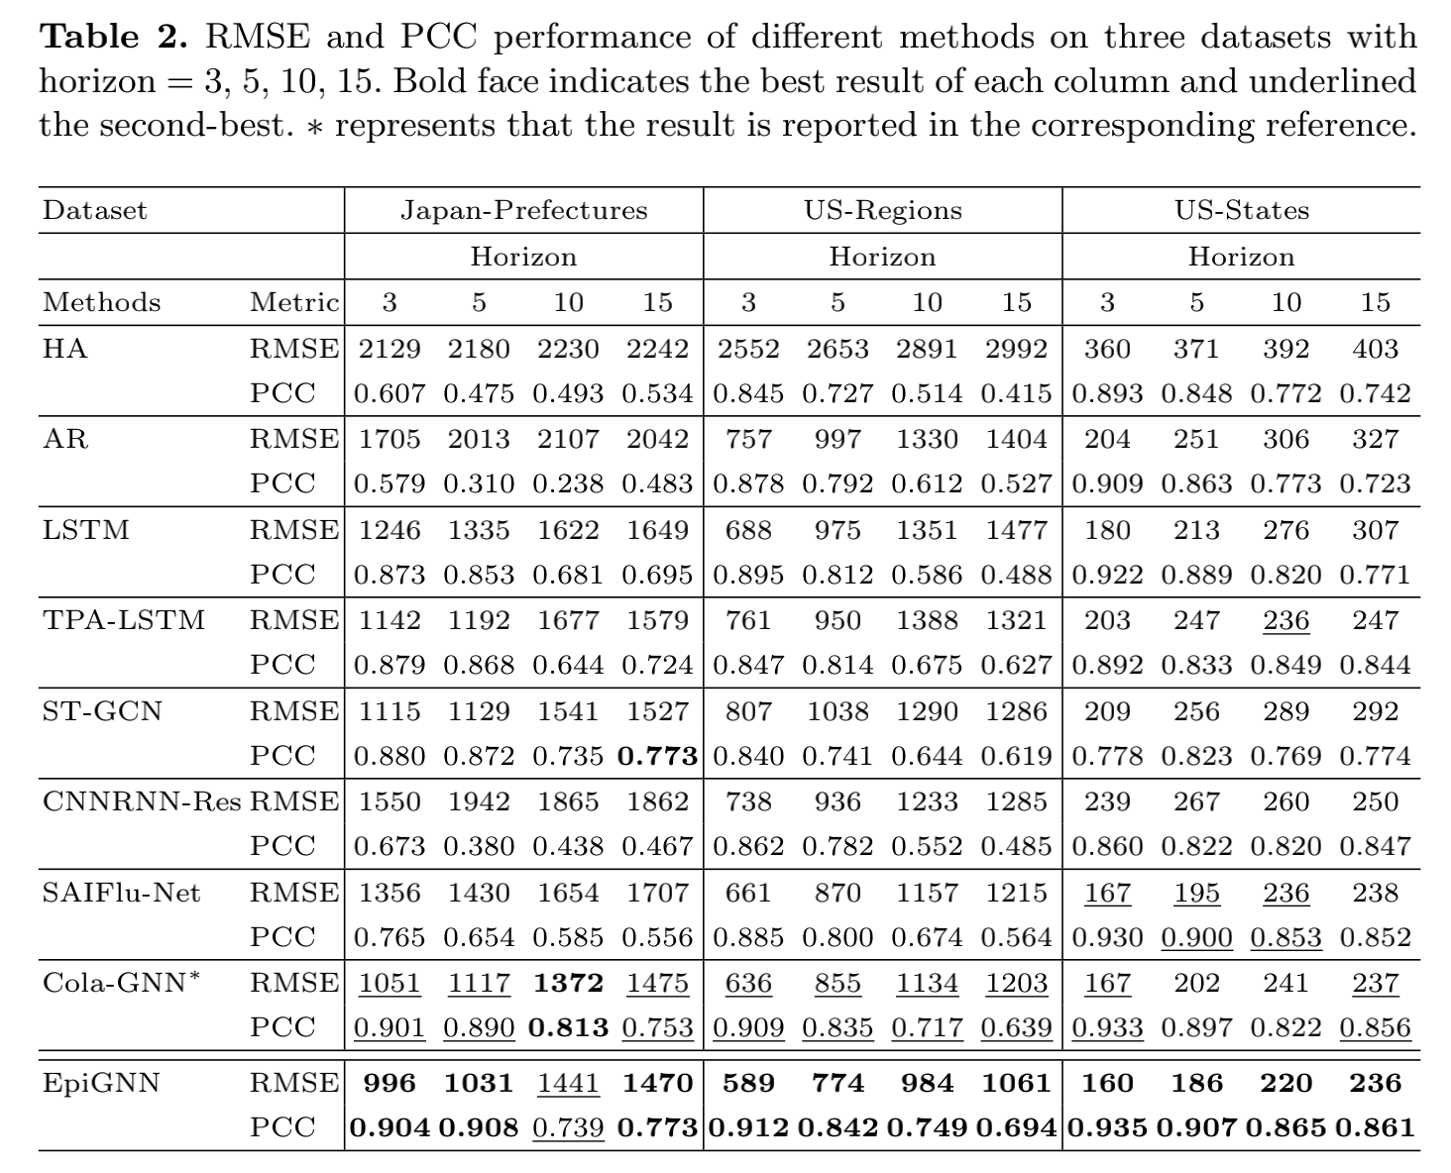
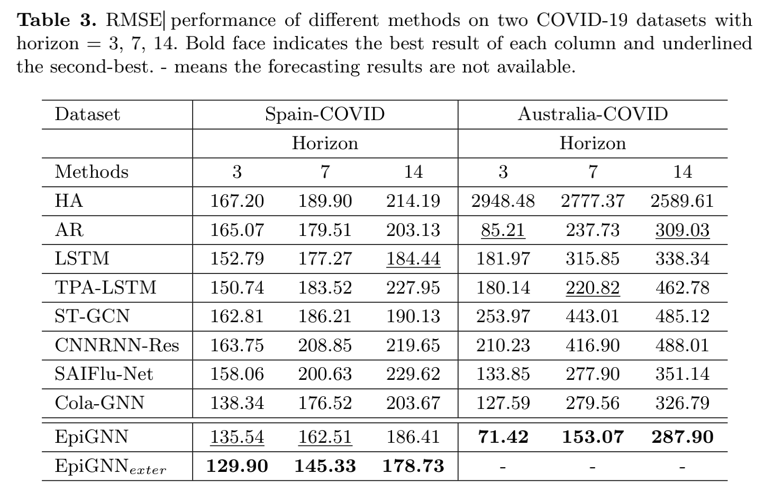
Experimental Results
We evaluate our model in short-term (horizon < 10) and long term (horizon >=10) settings.
Our method (EpiGNN) achieves the most stable and optimal performance on all datasets.

Slide 15
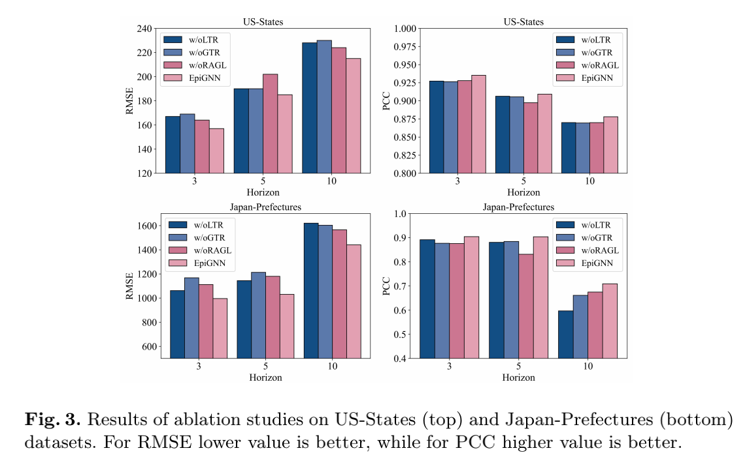
Experimental Results
- ablation study
w/oLTR stands for EpiGNN without local transmission risk encoding.
w/oGTR represents EpiGNN without global transmission risk encoding.
w/oRAGL indicates EpiGNN using self-attention [13] to capture dependencies between regions instead of Region-Aware Graph Learner (i.e., applying ).
We quantitatively show that the complete EpiGNN can yield the most stable and optimal performance compared to other incomplete models.

Slide 16
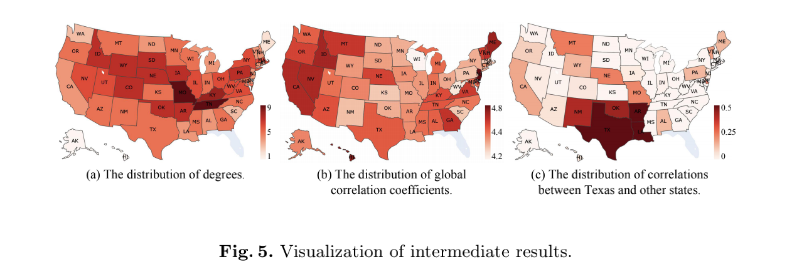
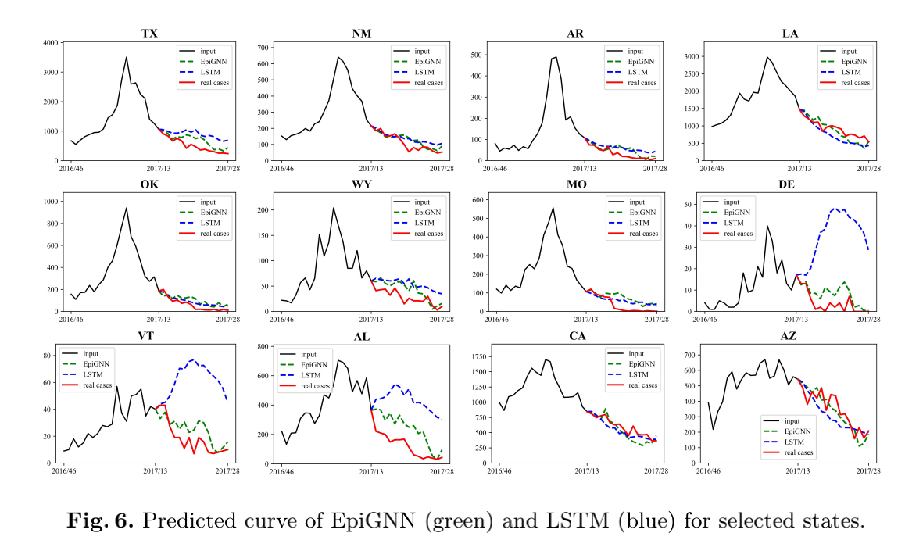
Experimental Results
We visualize an example with window=(2016/46th-2017/13th) and horizon=5 (week) in US-States dataset.
Texas does not have dependencies with all states. Nevertheless, Texas has relatively significant dependencies with its adjacent regions and also has relationships with some non-adjacent regions.
TX's adjacent states
The predicted curve of EpiGNN and LSTM in Fig. 6:
We observe that EpiGNN fits the ground truth better, and some trends of fluctuation are also predicted better (e.g., WY/DE/VT), while LSTM yields quite inaccurate predictions in some states.

Slide 17
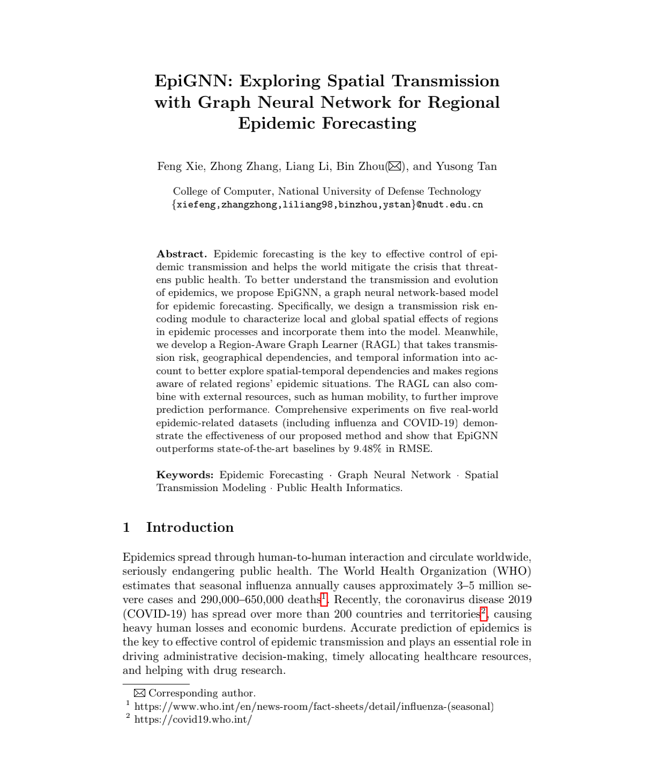
Conclusions
In this paper, we develop EpiGNN, a novel model for epidemic prediction. In this model, we design a transmission risk encoding module to characterize local and global spatial effects of each region.
Meanwhile, we propose a Region-Aware Graph Learner that takes transmission risk, geographical dependencies, and temporal information into account to better explore spatial-temporal dependencies.
Experimental results show the effectiveness and efficiency of our method on five epidemic-related datasets.
As for future work, we will devote to better predict by considering the time decay effects of spatial transmission.

Slide 18
References
[1] https://www.who.int/en/news-room/fact-sheets/detail/influenza-(seasonal)
[2] https://covid19.who.int/
[3] Han, X., Xu, Y., Fan, L., Huang, Y., Xu, M., Gao, S.: Quantifying covid-19 im_x0002_portation risk in a dynamic network of domestic cities and international countries. Proceedings of the National Academy of Sciences (2021)
[4] Songgaojun Deng, Shusen Wang, Huzefa Rangwala, Lijing Wang, and Yue Ning. 2020. Cola-gnn: Cross-location attention based graph neural networks for long_x0002_term ili prediction. In Proc. of CIKM.
[5] Wu, Z., Pan, S., Long, G., Jiang, J., Zhang, C.: Graph wavenet for deep spatial_x0002_temporal graph modeling. arXiv preprint arXiv:1906.00121 (2019)
[6] Kipf, T.N., Welling, M.: Semi-supervised classification with graph convolutional networks. arXiv preprint arXiv:1609.02907 (2016)
[7] Guokun Lai, Wei-Cheng Chang, Yiming Yang, and Hanxiao Liu. 2018. Modeling long-and short-term temporal patterns with deep neural networks. In Proc. of SIGIR.
[8] Shun-Yao Shih, Fan-Keng Sun, and Hung-yi Lee. 2019. Temporal pattern attention for multivariate time series forecasting. Machine Learning (2019).
[9] Sepp Hochreiter and Jürgen Schmidhuber. 1997. Long short-term memory. Neural computation (1997).
[10] Yu, B., Yin, H., Zhu, Z.: Spatio-temporal graph convolutional networks: A deep learning framework for traffic forecasting. arXiv preprint arXiv:1709.04875 (2017)
[11] Yuexin Wu, Yiming Yang, Hiroshi Nishiura, and Masaya Saitoh. 2018. Deep learning for epidemiological predictions. In Proc. of SIGIR.
[12] Seungwon Jung, Jaeuk Moon, Sungwoo Park, and Eenjun Hwang. 2021. Self-attention-based Deep Learning Network for Regional Influenza Forecasting. IEEE Journal of Biomedical and Health Informatics (2021).
[13] Vaswani, A., Shazeer, N., Parmar, N., Uszkoreit, J., Jones, L., Gomez, A.N., Kaiser, L., Polosukhin, I.: Attention is all you need. Proc. of NeurIPS (2017)

Slide 19
Thanks for your attention!
For more information, please refer to our paper and source codes:
paper: https://2022.ecmlpkdd.org/wp-content/uploads/2022/09/sub_829.pdf
source codes: https://github.com/Xiefeng69/EpiGNN
homepage: https://xiefeng69.github.io/
ACKNOWLEDGMENTS: This work is supported by the Key R&D Program of Guangdong Province No.2019B010136003 and the National Natural Science Foundation of China No. 62172428, 61732004, 61732022.

